Slide 1


Dr. Muzamil Ahmed (Assistant Professor) Namal University Mianwali
Natural Language Processing
Dependency Parsing

Slide 2

Lesson from Quran

Slide 3

Lecture Outline
What is dependency parsing
Constituency vs dependency structure
Dependency relations
Advantages of dependency structure
Dependency treebanks
Projectivity
Transition-based dependency parsing
MaltParser
Parsing with neural networks
Graph-based dependency parsing

Slide 4
Overview
What is dependency parsing? Two families of algorithms
Transition-based dependency parsing
Graph-based dependency parsing

Slide 5
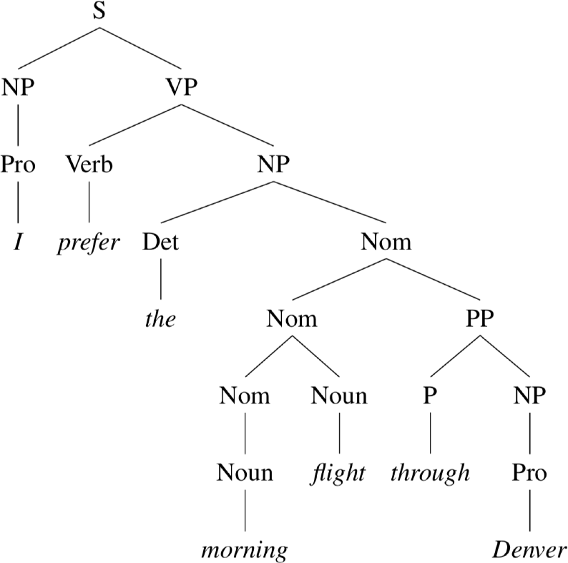
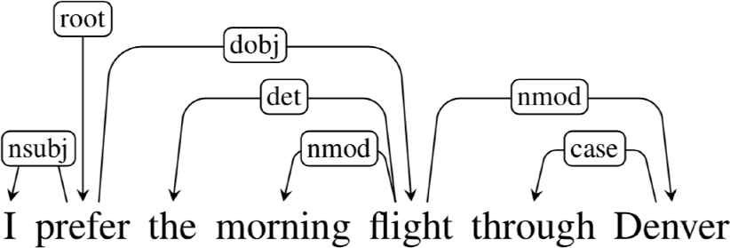
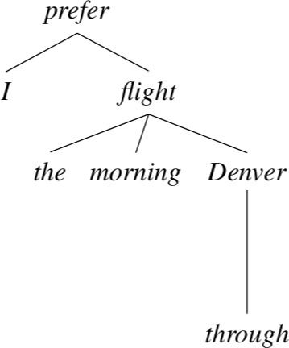
Constituency vs dependency structure

Slide 6

Dependency structure
•
•
Consists of relations between lexical items, normally binary, asymmetric relations (“arrows”) called dependencies
The arrows are commonly typed with the name of grammatical relations (subject, prepositional object, apposition, etc)
•
•
The arrow connects a head (governor) and a dependent (modifier) Usually, dependencies form a tree (single-head, connected, acyclic)
Notes:
Common grammatical relation labels
subject (nsubj) → performer of action
object (obj) → receiver of action
prepositional object (pobj) → noun after preposition
apposition (appos) → renaming noun
modifier (amod / advmod) → adjective or adverb modifier
det → determiner such as the, a, an

Slide 7
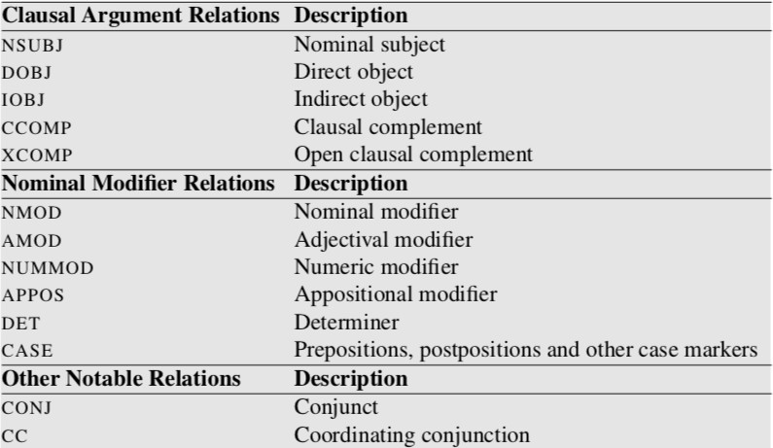
Dependency relations
(de Marneffe and Manning, 2008): Stanford typed dependencies manual
Notes:
Clausal Argument Relations
NSUBJ (Nominal Subject)
The noun that performs the action of the verb.
Example: Ali reads a book. → Ali = NSUBJ
DOBJ (Direct Object)
The noun directly receiving the action.
Example: Ali reads a book. → book = DOBJ
IOBJ (Indirect Object)
The noun indirectly affected by the action, usually recipient.
Example: Ali gave Sara a pen. → Sara = IOBJ
CCOMP (Clausal Complement)
A clause functioning as an object with its own subject.
Example: She said that she was tired. → clause = CCOMP
XCOMP (Open Clausal Complement)
A clause without its own explicit subject.
Example: She wants to study. → to study = XCOMP
Nominal Modifier Relations
NMOD (Nominal Modifier)
A noun modifying another noun.
Example: The book on the table → phrase = NMOD
AMOD (Adjectival Modifier)
An adjective modifying a noun.
Example: Red car → Red = AMOD
NUMMOD (Numeric Modifier)
A number modifying a noun.
Example: Three students → Three = NUMMOD
APPOS (Appositional Modifier)
A noun giving extra information about another noun.
Example: Albert Einstein, the scientist → scientist = APPOS
DET (Determiner)
Words like the, a, an, this.
Example: The boy → The = DET
CASE
Prepositions or case markers showing grammatical relation.
Example: in the room → in = CASE
Other Notable Relations
CONJ (Conjunct)
A word linked in coordination.
Example: Ali and Ahmed → Ahmed = CONJ
CC (Coordinating Conjunction)
The connector word in coordination.
Example: Ali and Ahmed → and = CC

Slide 8
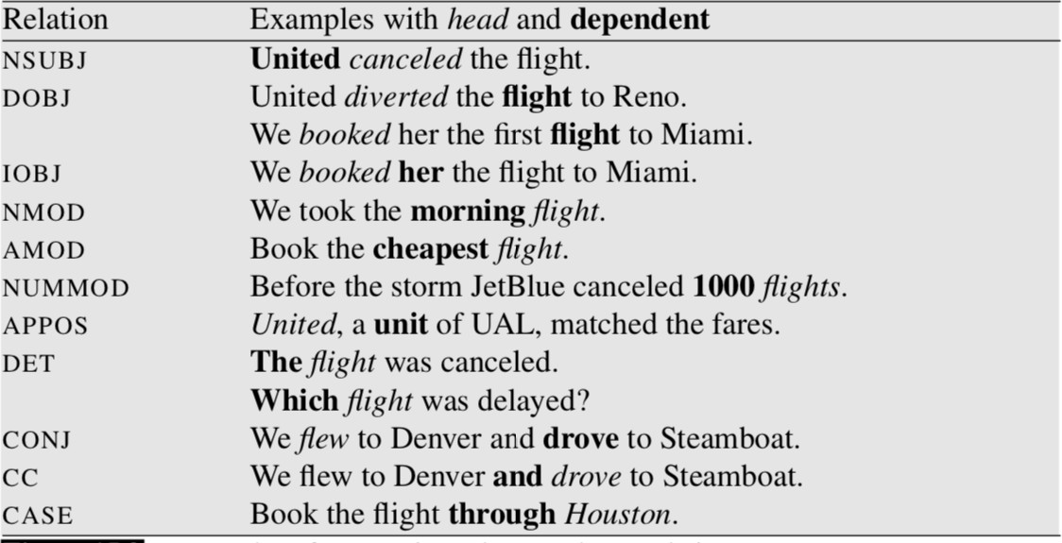
Dependency relations
(de Marneffe and Manning, 2008): Stanford typed dependencies manual

Slide 9
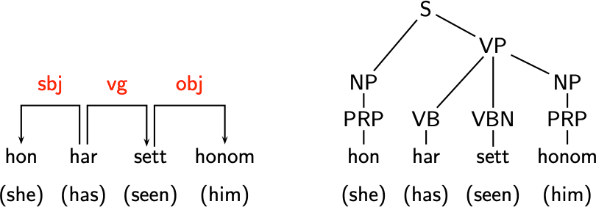
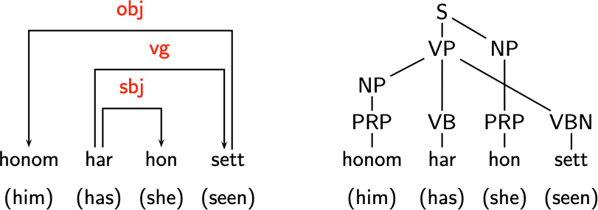
Advantages of dependency structure
•
More suitable for free word order languages

Slide 10
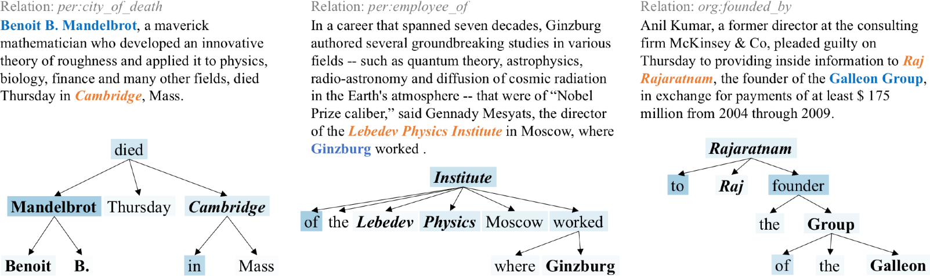
Advantages of dependency structure
•
More suitable for free word order languages
•
The predicate-argument structure is more useful for many applications

Slide 11
Dependency parsing
Input:
Output:
I prefer the morning flight through Denver
•
•
•
A sentence is parsed by choosing for each word what other word is it a dependent of (and also the relation type)
We usually add a fake ROOT at the beginning so every word has one head
Usually some constraints:
•
•
Only one word is a dependent of ROOT No cycles: A —> B, B —> C, C —> A
Learning from data: treebanks!

Slide 12
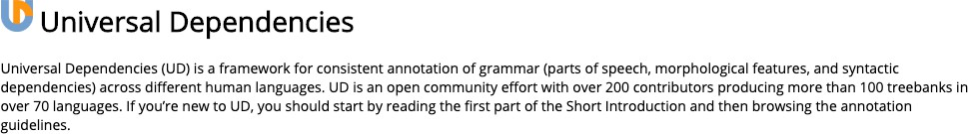
Dependency treebanks
•
The major English dependency treebank: converting from Penn Treebank using rule-based algorithms
•
•
(De Marneffe et al, 2006): Generating typed dependency parses from phrase structure parses
(Johansson and Nugues, 2007): Extended Constituent-to-dependency Conversion for English
•
Universal Dependencies: more than 100 treebanks in 70 languages were collected since 2016
https://universaldependencies.org/

Slide 13
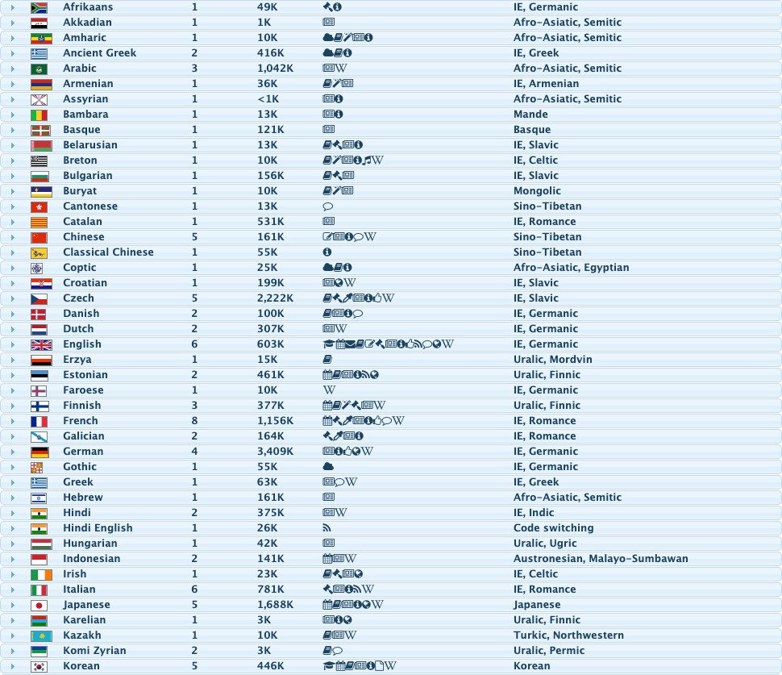
Universal Dependencies

Slide 14
Universal Dependencies
Manning’s Law:
•
•
•
•
•
•
UD needs to be satisfactory for analysis of individual languages. UD needs to be good for linguistic typology.
UD must be suitable for rapid, consistent annotation.
UD must be suitable for computer parsing with high accuracy. UD must be easily comprehended and used by a non-linguist. UD must provide good support for downstream NLP tasks.
Notes:
Universal Dependencies (UD) is a standard framework for grammatical annotation that represents sentence structure in a consistent dependency format across many languages 🌍📘
Simple definition
It provides:
a common set of dependency relation labels
a common part-of-speech tag system
a shared annotation guideline for many languages
This allows English, Arabic, Urdu, Chinese, Swedish, etc. to be analyzed using the same syntactic principle
Meaning of each point
1) UD needs to be satisfactory for analysis of individual languages
The framework must correctly describe grammar inside each language.
Example: English and Urdu have different word order, but both should still be representable.
2) UD needs to be good for linguistic typology
It should allow comparison across languages.
That means:
same relation labels
same structural principles
so languages can be studied together
3) UD must be suitable for rapid, consistent annotation
Annotators should apply rules quickly and uniformly.
If rules are too complex, different annotators will produce inconsistent trees.
4) UD must be suitable for computer parsing with high accuracy
The annotation scheme should be learnable by parsers.
A parser should predict relations reliably from data
5) UD must be easily comprehended and used by a non-linguist
Even engineers and NLP developers should understand labels easily.
Example:
nsubj = subject
obj = object
Simple labels improve adoption.
6) UD must provide good support for downstream NLP tasks
The output should help applications such as:
machine translation
question answering
information extraction
summarization
Because dependency structure should be useful after parsing.

Slide 15
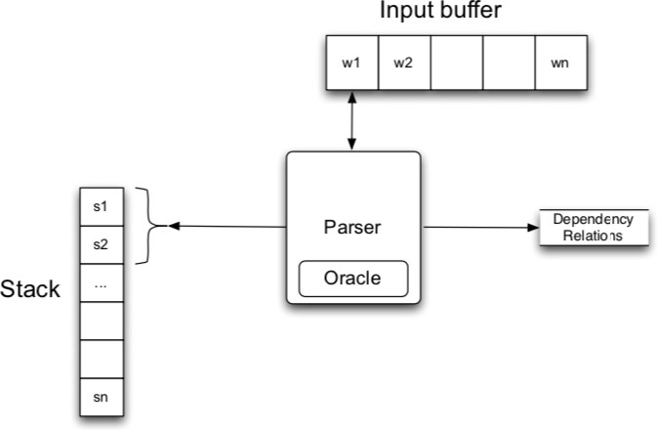
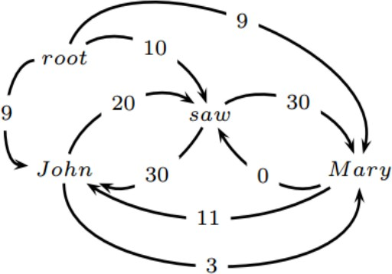
Two families of algorithms
Transition-based dependency parsing
Also called “shift-reduce parsing”
Graph-based dependency parsing

Slide 16
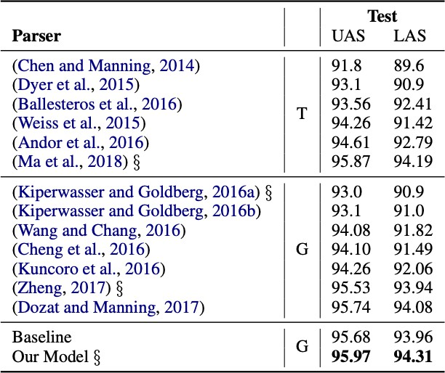
Two families of algorithms
T: transition-based / G: graph-based

Slide 17
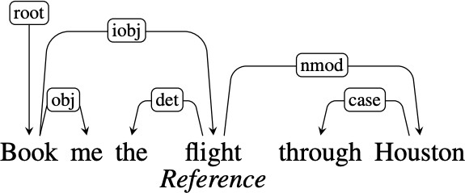
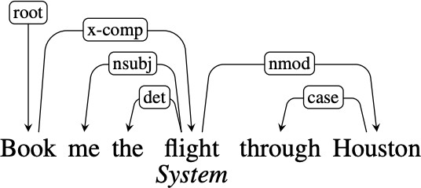
Evaluation
•
•
Unlabeled attachment score (UAS)
= percentage of words that have been assigned the correct head
Labeled attachment score (LAS)
= percentage of words that have been assigned the correct head & label
UAS = ?
LAS = ?

Slide 18
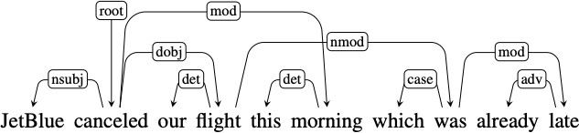
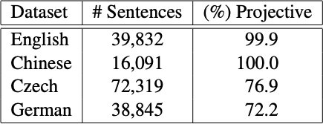
Projectivity
•
Definition: there are no crossing dependency arcs when the words are laid out in their linear order, with all arcs above the words
projective
non-projective
Non-projectivity arises due to long distance dependencies or in languages with flexible word order.
This class: focuses on projective parsing

Slide 19
Transition-based dependency parsing
•
•
The parsing process is modeled as a sequence of transitions
A configuration consists of a stack , a buffer and a set of
dependency arcs
: c = (s, b, A)
•
•
Initially, s = [ROOT], b = [w₁, w₂, …, w_{n}], A = ∅
Three types of transitions (s₁, s₂: the top 2 words on the stack; b₁: the first word in the buffer)
•
•
•
LEFT-ARC ( ): add an arc (s ^{r} s ) to , remove s from the stack
1 2 2
RIGHT-ARC ( ): add an arc (s ^{r} s ) to , remove s from the stack
2 1 1
SHIFT: move b₁ from the buffer to the stack
•
A configuration is terminal if s = [ROOT] and b = ∅
This is called “Arc-standard”; There are other transition schemes…

Slide 20
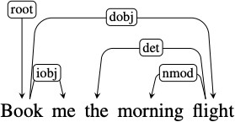
A running example
stack
buffer
action
added arc
0 | [ROOT] | [Book, me, the, morning, flight] | SHIFT
1 | [ROOT, Book] | [me, the, morning, flight] | SHIFT
2 | [ROOT, Book, me] | [the, morning, flight] | RIGHT-ARC(iobj) | (Book, iobj, me)
3 | [ROOT, Book] | [the, morning, flight] | SHIFT
4 | [ROOT, Book, the] | [morning, flight] | SHIFT
5 | [ROOT, Book, the, morning] | [flight] | SHIFT
6 | [ROOT, Book, the,morning,flight] | [] | LEFT-ARC(nmod) | (flight,nmod,morning)
7 | [ROOT, Book, the, flight] | [] | LEFT-ARC(det) | (flight,det,the)
8 | [ROOT, Book, flight] | [] | RIGHT-ARC(dobj) | (Book,dobj,flight)
9 | [ROOT, Book] | [] | RIGHT-ARC(root) | (ROOT,root,Book)
10 | [ROOT] | []
“Book me the morning flight”

Slide 21
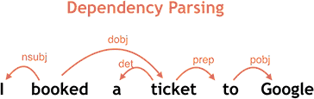
Transition-based dependency parsing
https://ai.googleblog.com/2016/05/announcing-syntaxnet-worlds-most.html

Slide 22
Transition-based dependency parsing
How many transitions are needed? How many times of SHIFT?
Correctness:
For every complete transition sequence, the resulting graph is a projective dependency forest (soundness)
For every projective dependency forest G, there is a transition sequence that generates G (completeness)
•
However, one parse tree can have multiple valid transition sequences. Why?
“He likes dogs”
•
•
•
Stack = [ROOT He likes] Buffer = [dogs]
Action = ??

Slide 23
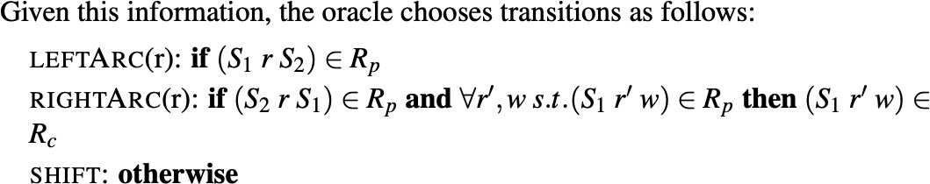
Train a classifier to predict actions!
•
•
Given{x_{i}, y_{i}} where x_{i} is a sentence and y_{i} is a dependency parse
For each x_{i} with
words, we can construct a transition sequence
of length 2 which generates y_{i}, so we can generate 2n training
examples: {(c_{k}, a_{k})}
_{k}: configuration, a_{k}: action
•
“shortest stack” strategy: prefer LEFT-ARC over SHIFT.
•
The goal becomes how to learn a classifier from _{i} to a_{i}
How many training examples? How many classes?
Notes:
S₁ = top of stack S₂ = second item in stack r = dependency relation (e.g., subject, object) Rₚ = set of gold (correct) dependency arcs R𝚌 = set of already constructed arcs
Meaning:
If in the gold tree:
S₁ is the head of S₂
Then: Create arc: S₁ → S₂ Remove S₂ from stack For all relations $r^{′}$and words $w$, if $S_{1}$has a dependency to $w$in the gold tree, then that dependency must already be constructed. All children (dependents) of S₁ must already be attached before we proceed “Don’t remove S₁ until all its dependents are already built”

Slide 24
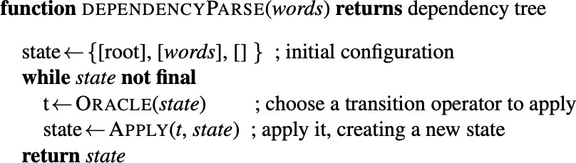
Train a classifier to predict actions!
•
During testing, we use the classifier to repeat predicting the action, until we reach a terminal configuration
Classifier
•
This is also called “greedy transition-based parsing” because we always make a local decision at each step
•
•
It is very fast (linear time!) but less accurate Can easily do beam search
Notes:
“Can easily do beam search”
Idea:
Instead of keeping one path, keep k best paths

Slide 25
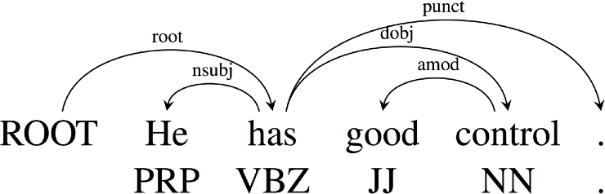
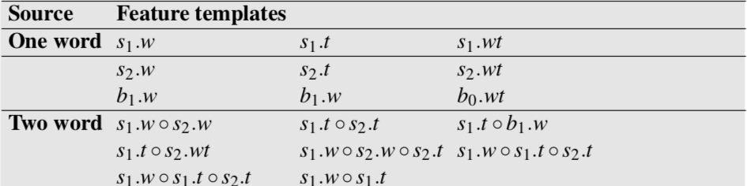
MaltParser
Stack
Bu↵er
ROOT
has VBZ
nsubj
He PRP
good JJ
control NN
. .
•
•
Extract features from the configuration
Use your favorite classifier: logistic regression, SVM…
w: word, t: part-of-speech tag
(Nivre 2008): Algorithms for Deterministic Incremental Dependency Parsing

Slide 26
MaltParser
Features
s₂ . w = has ∘ s₂ . t = VBZ
s₁ . w = good ∘ s₁ . t = JJ ∘ b₁ . w = control
lc(s₂) . t = PRP ∘ s₂ . t = VBZ ∘ s₁ . t = JJ
Stack
Bu↵er
ROOT
has VBZ
nsubj
He PRP
good JJ
control NN
. .
Feature templates
s₂ . w ∘ s₂ . t
s₁ . w ∘ s₁ . t ∘ b₁ . w lc(s₂) . t ∘ s₂ . t ∘ s₁ . t
lc(s₂) . w ∘ lc(s₂) . l ∘ s₂ . w
lc(s₂) . w = He ∘ lc(s₂) . l = nsubj ∘ s₂ . w = has
Usually a combination of 1-3 elements from the configuration
Binary, sparse, millions of features
(Nivre 2008): Algorithms for Deterministic Incremental Dependency Parsing

Slide 27
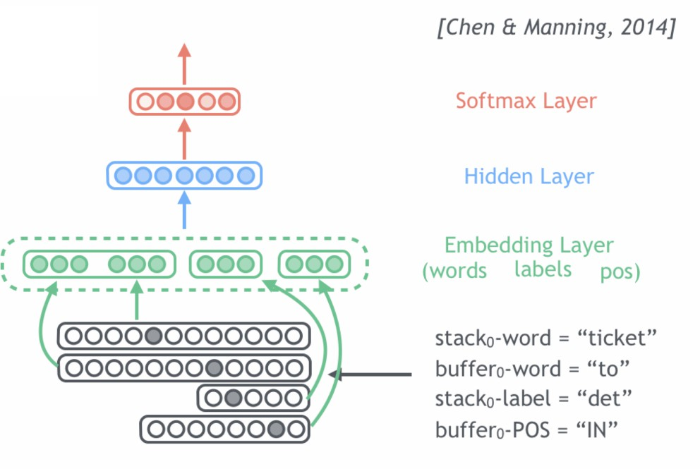
Parsing with neural networks
(Chen and Manning, 2014): A Fast and Accurate Dependency Parser using Neural Networks

Slide 28
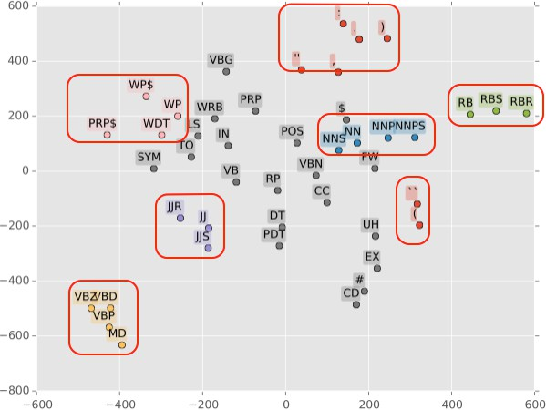
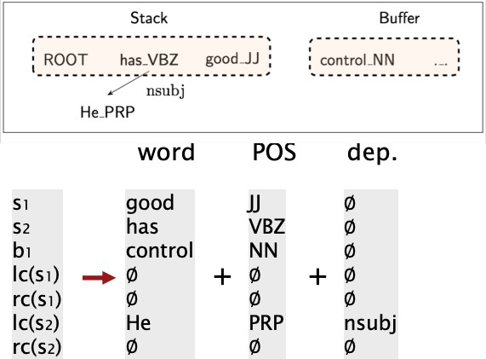
Parsing with neural networks
Used pre-trained word embeddings
Part-of-speech tags and dependency labels are also represented as vectors
No feature template any more!
•
A simple feedforward NN: what is left is backpropagation!
(Chen and Manning, 2014): A Fast and Accurate Dependency Parser using Neural Networks

Slide 29
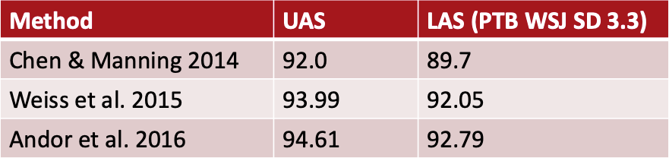
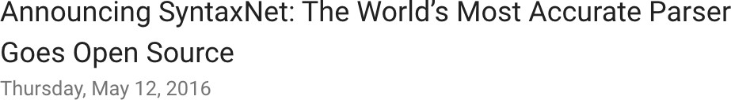
Further improvements
•
•
•
Bigger, deeper networks with better tuned hyperparameters Beam search
Global normalization
Google’s SyntaxNet and the Parsey McParseFace (English) model
Notes:
Bigger networks → more neurons, larger embeddings Deeper networks → more layers (e.g., multi-layer LSTMs, Transformers)
Local normalization (softmax at each step)

Slide 30
Handling non-projectivity
•
•
The arc-standard algorithm we presented only builds projective dependency trees
Possible directions:
•
•
•
•
Give up!
Post-processing
Add new transition types (e.g., SWAP)
Switch to a different algorithm (e.g., graph-based parsers such as MSTParser)

Slide 31
Graph-based dependency parsing
•
Basic idea: let’s predict the dependency tree directly
Y* = argmax_{Y∈Φ(X)}score(X, Y )
X: sentence, Y: any possible dependency tree
•
Factorization:
score(X, Y ) = ∑ score(e) = ∑ w⊺f(e)
e∈Y e∈Y
•
Inference: finding maximum spanning tree (MST) for weighted, directed graph
Notes:
Graph-based parsing treats a sentence as a graph problem:
Each word = a node
Possible dependencies between words = edges
Each edge has a score (weight)
Goal: Find the best dependency tree (highest total score) considers all possible dependencies at once then selects the globally optimal tree

Slide 32

Thanks

